Slide 1
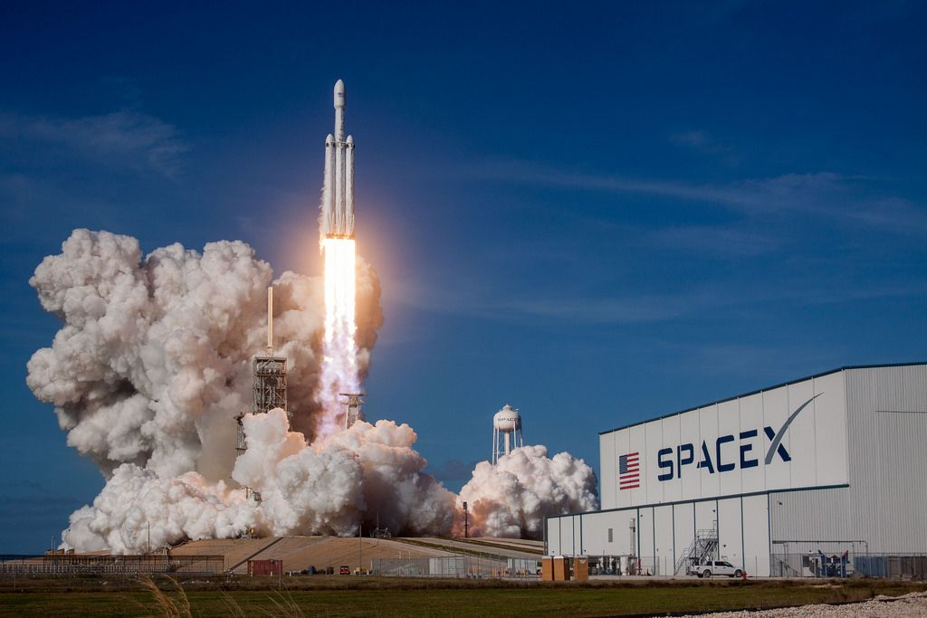
IBM Data Science Capstone Project
David Tolulope Oludowole
23/05/2022

Slide 2
Executive Summary
In this project, we present data collected from SpaceX and Wikipedia.
We explored the data using Exploratory Data Analysis EDA using Python and SQL.
Visualisation maps (Folium) and Dashboards were also generated to show relevant information as regards successful landings.
Machine Learning models (Logistic Regression, Support Vector Machine, Decision Tree Classifier and K Nearest Neighbours) were also deployed to model the dataset.

Slide 3
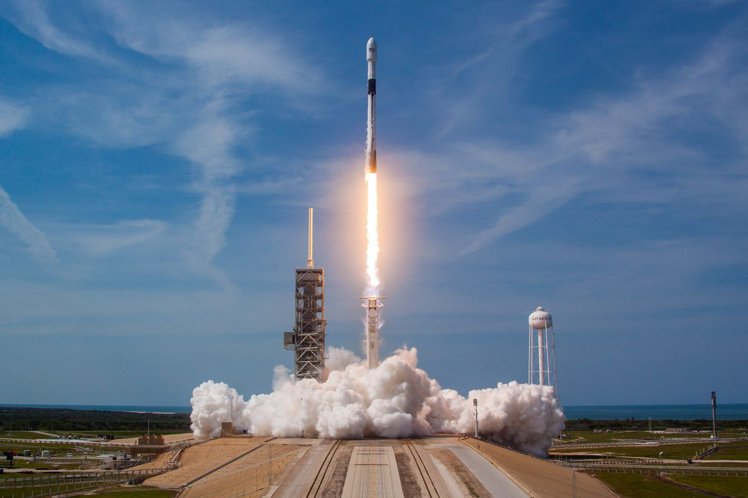
Table of Contents
Executive Summary
Introduction
Methodology
Results and Discussion
Conclusion
Appendix

Slide 4
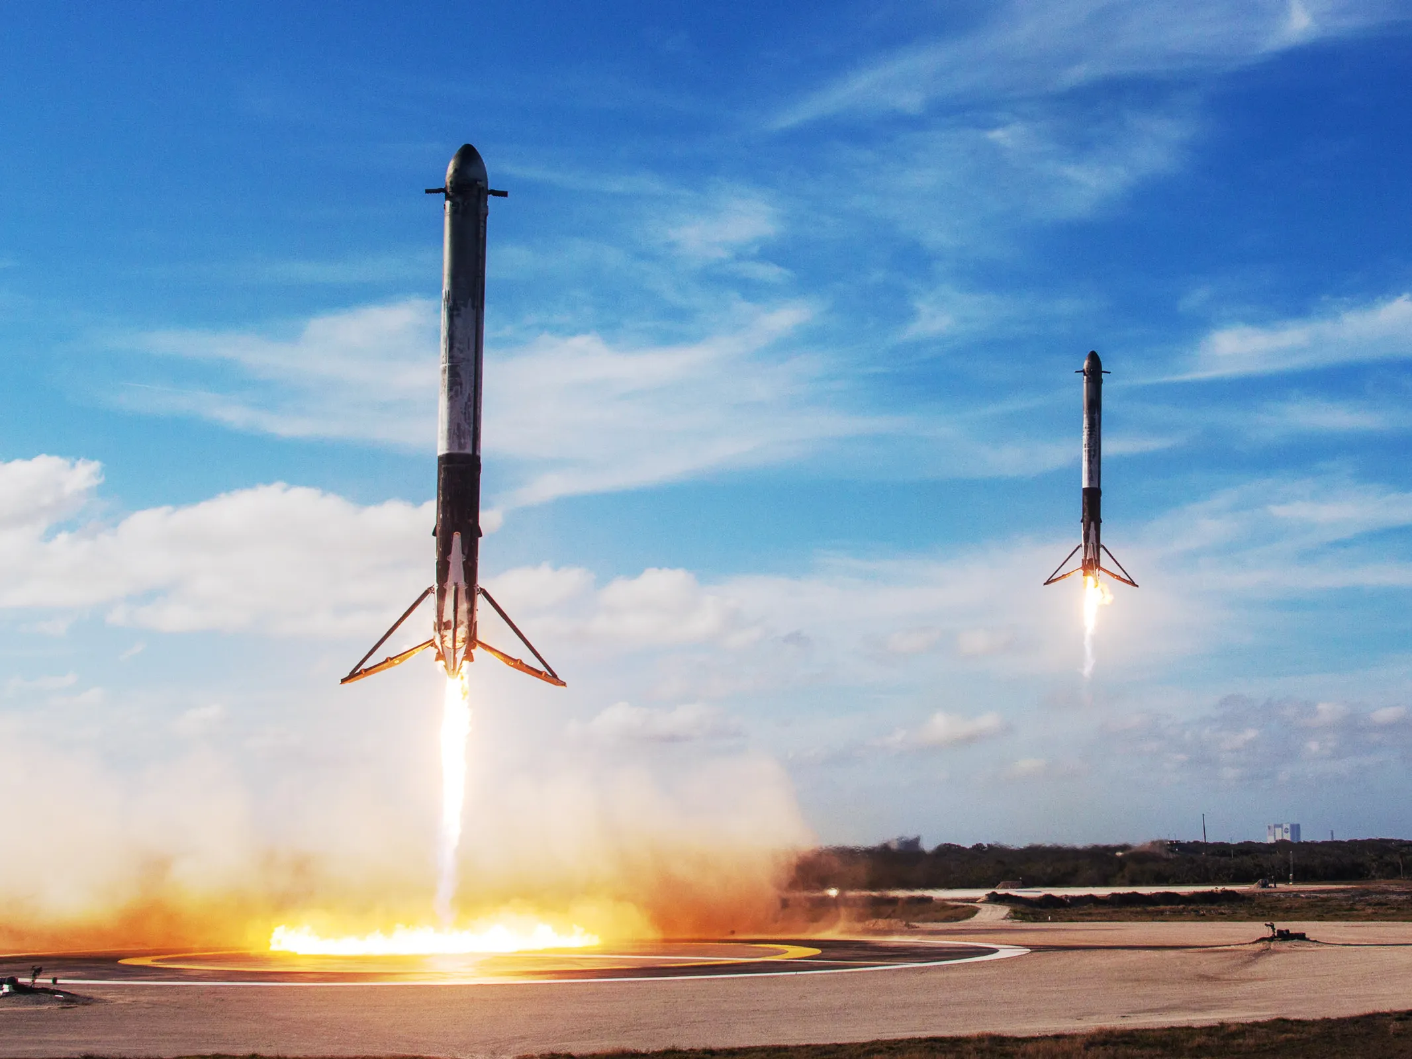
Introduction
The launching of a SpaceX Falcon 9 rockets cost approx. $62m
This is way cheaper compared to other providers (Cost approx. $165m)
The difference is price is because SpaceX rockets can land, and be re-used again.
If we can determine if the first stage will land, we can determine the cost of the launch.
This information will guide us if our new company Space Y should compete in the Space travel sector
SpaceX Falcon 9 Rocket – The Verge

Slide 5
Methodology

Slide 6
Methodology
Data Collection
Using GET requests from SpaceX REST API
Web scraping from Wikipedia's page
Data Wrangling and Manipulation
Removing NaN values with the .fillna() method
Calculating number of launches and missions using the .value_counts() method
Exploratory Data Analysis (EDA)
Using SQL, Python Libraries (Pandas, Matplotlib) to visualise data and explore realtionships
Interactive Data Analysis
Generating geospatial analysis using Folium and interactive dashboards using Plotly Dash
Data Modelling and Evaluation

Slide 7
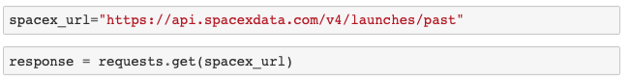
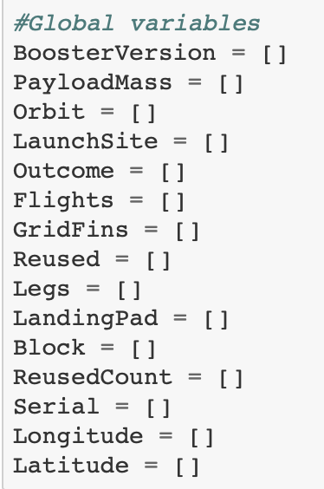
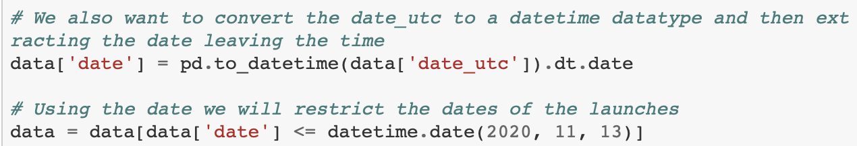
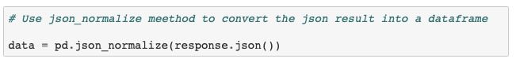
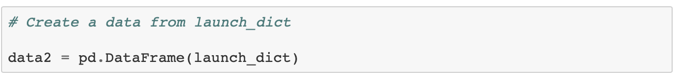
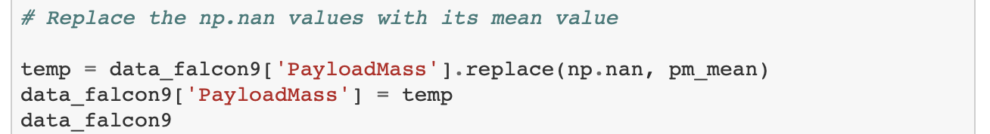
Data Collection (SPACEX REST API)
Step 1
Make GET requests from SpaceX REST API
Convert the response to a .json file and use pandas to generate the data frame.
Step 2
Clean Data
Create Lists
Call Functions
Convert the response
to a .json file
Step 3
Create Pandas Dataframe
Step 4
Filter Data in the dataframe, Replace missing values

Slide 8
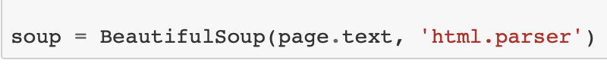
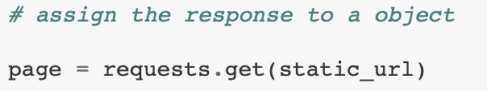
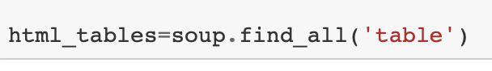
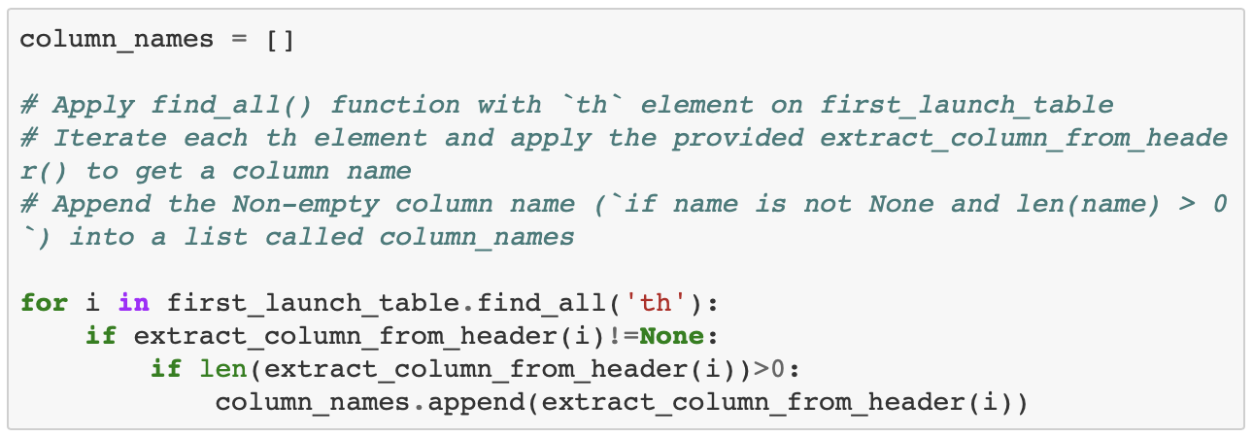
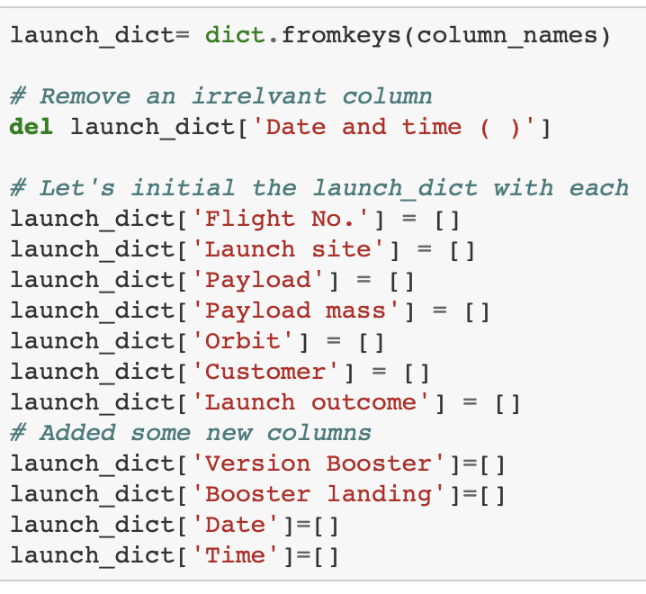
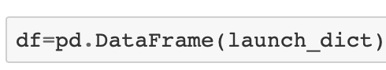
Data Collection (WEB SCRAPING)
Step 1
Request HTML page
Assign response to an object
Step 2
Create BeautifulSoup object
Fill all the table in the HTML Page
Step 3
Extract Column Names from tables in HTML Page
Step 4
Use column names as keys in dictionaries
Convert to Pandas

Slide 9
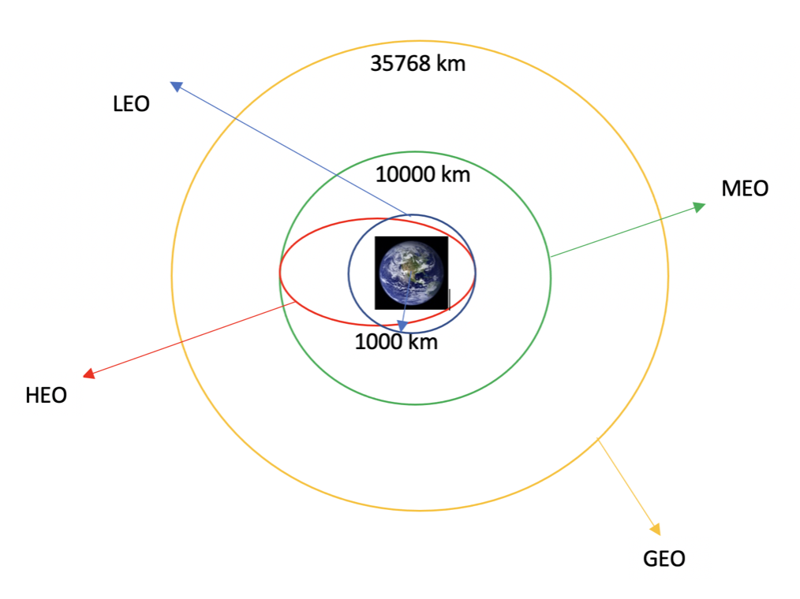
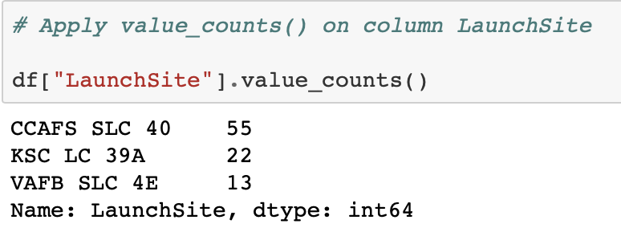
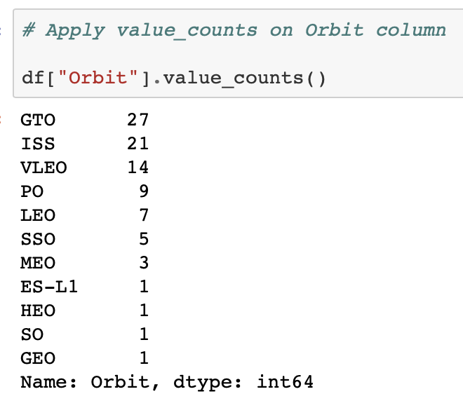
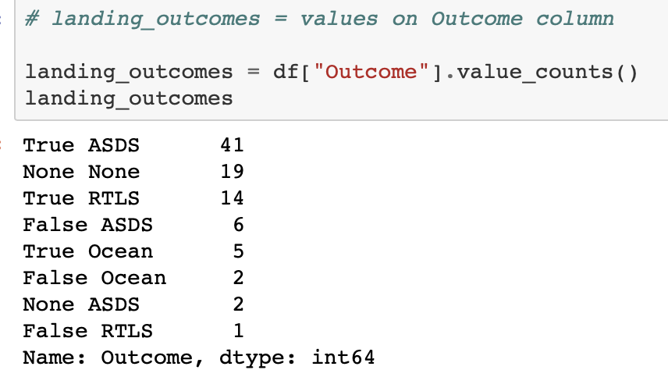
Data Wrangling and Manipulation
The dataset contains several SpaceX launch facilities and each location is in the LaunchSite column.
Initial Data Exploration [No of Launches, Occurrence of each Orbit, Landing outcome per orbit]

Slide 10
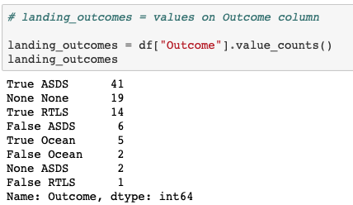
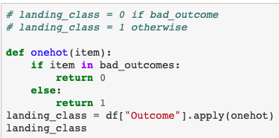
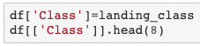
Data Wrangling and Manipulation
Creating a list [landing_class]to check if the booster would land successfully or not.
Displaying the Landing Outcome Columns
Exporting the Data frame to a .csvfile

Slide 11
Exploratory Data Analysis [EDA] with Data Visualisation
Exploratory Data Analysis was performed on certain variables and displayed using various tools
SCATTER PLOTS
Flight Number vs Launch Site
Payload vs Launch Site
Orbit Type vs Flight Number
Payload vs Orbit Type
BAR CHARTS
Success Rate vs Orbit Type
LINE CHARTS
Success Rate vs Year
**This analysis were used to compare relationships between different variables in the dataset

Slide 12
Exploratory Data Analysis [EDA] with SQL
Loading the Dataset using the IBM DB2 Database
Query the Data using Python
Performed different queries (10) to understand the dataset better
Queries included [Displaying: names of unique launch sites, average payload mass carried by booster version etc…… ]

Slide 13
Interactive Visual Analysis [IVA]
FOLIUM
Visualising the Data on Folium was done in the following steps
Marking all the launch sites on a map
Marking successful and unsuccessful landing on the map
Calculating distance from launch sites to key locations (E.g. Railway, Highway and City)

Slide 14
Interactive Dashboard
PLOTLY DASH
Creating an interactive dashboard with Pie charts and Scatter Plots/Graphs
Pie chart
Used to show distribution of successful launches across all launch sites
Shows success/failure ratio for each individual site
Scatter plot
Shows us how success varies across different launch sites, payload mass and booster version

Slide 15
Predictive Analysis [Classification]
Model Development
Model Evaluation
Best Fit Classification
Steps for model development:
Loading dataset
Performing necessary data transformations (standardise and pre-process)
Split data into training and test data sets, using train_test_split()
Decide which type of machine learning algorithms are most appropriate
Creating a GridSearchCV (Logreg, SVM, Decision Tree and KNN Model)
Fitting the object to the parameters
Using the training data set to train the model
Plotting and examining the Confusion matrix
Checking accuracy
Checking tuned hyperparameters
Review Accuracy Score
Check which accuracy score is the highest to determine the best performing model

Slide 16
Results and Discussion
Exploratory Data Analysis
Interactive Analysis
Predictive Analysis

Slide 17
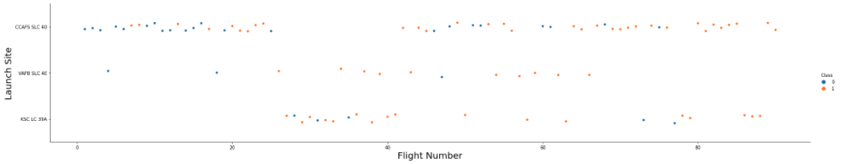
Launch Site vs Flight Number
Exploratory Data Analysis with Visualization
The scatter plot of Launch Site vs. Flight Number shows that:
Increase in success rate at launch site.
Most of the early flights that were launched from CCAFS SLC 40 were generally unsuccessful.
Flights launched from KSC LC 39A were successful.

Slide 18
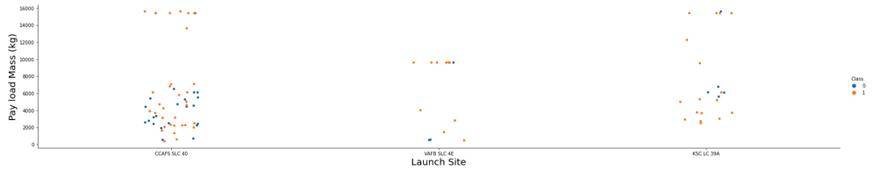
Payload Mass vs Launch Site
Exploratory Data Analysis with Visualization
The scatter plot of Payload mass vs Launch Site shows that:
Payload mass above 7000 kg have some successful landing, but little data for this launches
There is no correlation between payload mass and success rate for launch sites

Slide 19
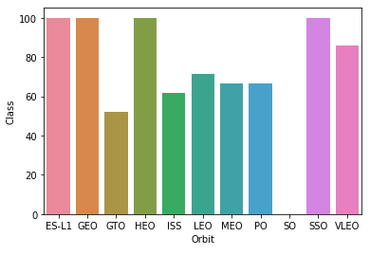
Success rate of each orbit type
Exploratory Data Analysis with Visualization
Orbits with 100% success rate
ES-L1 (Earth-Sun First Lagrangian Point),
GEO (Geostationary Orbit),
HEO (High Earth Orbit),
SSO (Sun-synchronous Orbit)
Orbits with 0% success rate
SO (Heliocentric Orbit)

Slide 20
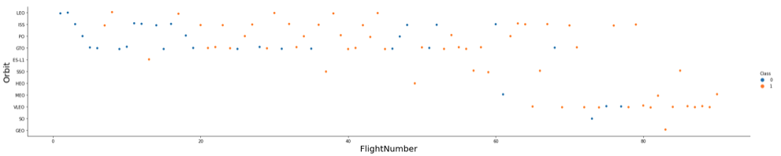
Orbit Type vs Flight Number
Exploratory Data Analysis with Visualization
The scatter plot of Orbit Type vs Flight Number shows that:
The 100% success rate of GEO, HEO, and ES-L1 orbits can be explained by only having 1 flight into the respective orbits.
Success rate in SSO is more impressive, with 5 successful flights.
Relationship between Flight Number and Success Rate for GTO is little.

Slide 21
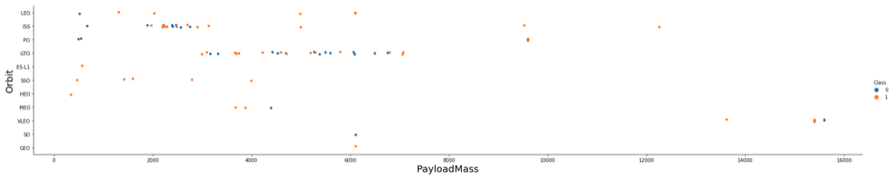
Orbit Type vs Payload Mass
Exploratory Data Analysis with Visualization
The scatter plot of Orbit Type vs Payload Mass shows that:
Orbits types (PO, ISS and LEO) have more success with heavy payloads
Relationship between payload mass and success rate in GTO is unclear.
VLEO (Very Low Earth Orbit) launches are associated with heavier payloads.

Slide 22
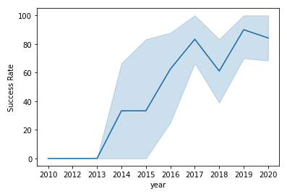
Launch Success Yearly Trend
Exploratory Data Analysis with Visualization
Between 2010 – 2013, all landings were unsuccessful
After 2013, success rate for launches increased (minor dips in 2018 and 2020)

Slide 23
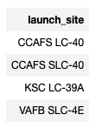
All Launch Name Sites
Exploratory Data Analysis with SQL
Find the names of the unique sites.
**The word UNIQUE returns only unique values from the LAUNCH_SITE column of the SPACEXTBL table.

Slide 24
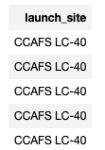
Launch Sites with names beginning with ‘CCA’
Exploratory Data Analysis with SQL
Display 5 records where launch sites begin with the string ‘CCA’.
**LIMIT 5 fetches only 5 records, and the LIKE keyword is used with the wild card ‘CCA%’ to retrieve string values beginning with ‘CCA’.

Slide 25
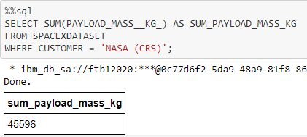
Total payload mass carried by Boosters from NASA
Exploratory Data Analysis with SQL
**The SUM keyword is used to calculate the total of the LAUNCH column, and the SUM keyword (and the associated condition) filters the results to only boosters from NASA (CRS).

Slide 26
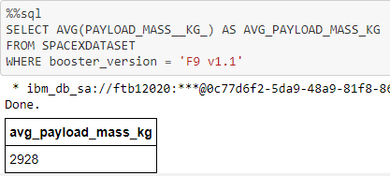
Average Payload Mass Carried by Booster Version F9 v1.1
Exploratory Data Analysis with SQL
**The AVG keyword is used to calculate the average of the PAYLOAD_MASS__KG_ column, and the WHERE keyword (and the associated condition) filters the results to only the F9 v1.1 booster version.

Slide 27
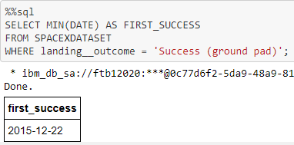
First Successful Landing Date
Exploratory Data Analysis with SQL
**The MIN keyword is used to calculate the minimum of the DATE column, i.e. the first date, and the WHERE keyword (and the associated condition) filters the results to only the successful ground pad landings.

Slide 28
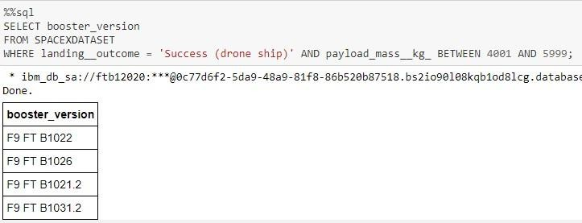
Names of Boosters with Success in Drone Ship and Payload Mass > 4000 and < 6000.
Exploratory Data Analysis with SQL
**The WHERE keyword is used to filter the results to include only those that satisfy both conditions in the brackets (as the AND keyword is also used). The BETWEEN keyword allows for 4000 < x < 6000 values to be selected.

Slide 29
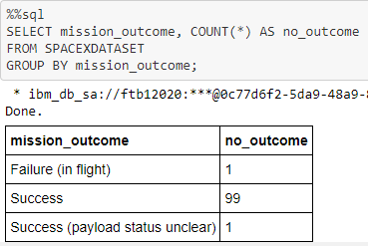
Total Number of Successful and Failure Missions
Exploratory Data Analysis with SQL
**The COUNT keyword is used to calculate the total number of mission outcomes, and the GROUPBY keyword is also used to group these results by the type of mission outcome.

Slide 30
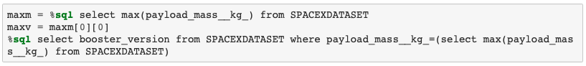
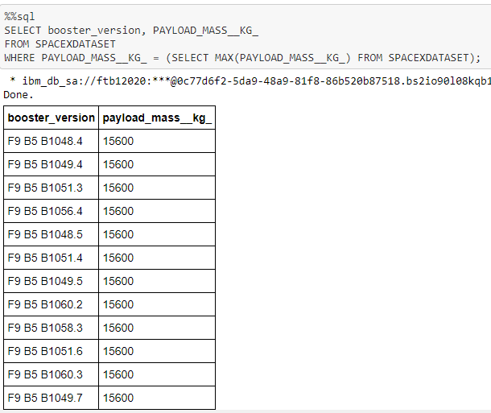
Names of Booster_Versions that have carried Maximum Payload Mass
Exploratory Data Analysis with SQL
**The SELECT statement within the brackets finds the maximum payload, and this value is used in the WHERE condition. The DISTINCT keyword is then used to retrieve only distinct /unique booster versions.

Slide 31
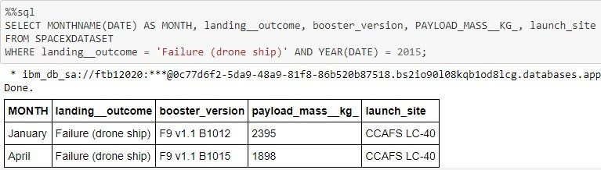
Failed Landing Outcomes in Drone Ship for 2015
Exploratory Data Analysis with SQL
**The WHERE keyword is used to filter the results for only failed landing outcomes, AND only for the year of 2015.

Slide 32
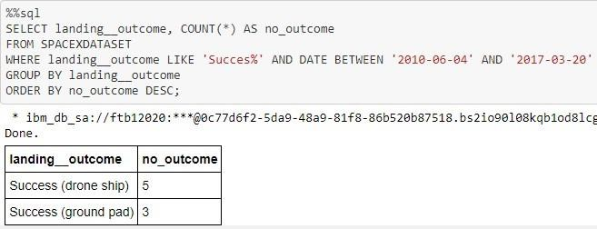
Ranking Landing Outcomes Between 2010-06-04 and 2017-03-20
Exploratory Data Analysis with SQL
**The WHERE keyword is used with the BETWEEN keyword to filter the results to dates only within those specified. The results are then grouped and ordered, using the keywords GROUP BY and ORDER BY, respectively, where DESC is used to specify the descending order.

Slide 33




Launch Site Locations
Interactive Analysis with FOLIUM
SpaceX launch sites are on coasts of the United States of America, specifically Florida and California.

Slide 34





Success and Failed Launches For Each Site
Interactive Analysis with FOLIUM
Launches have been grouped into clusters, green icons for successful launches, and red icons for failed launches.
CCAFS SLC-40 and CCAFS LC-40
VAFB SLC-4E
KSC LC-39A

Slide 35
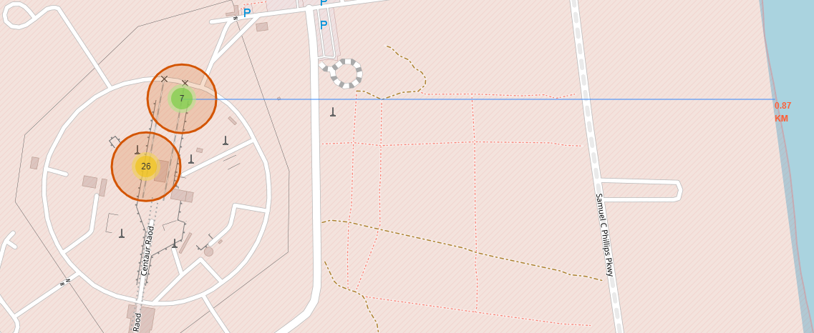
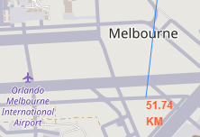
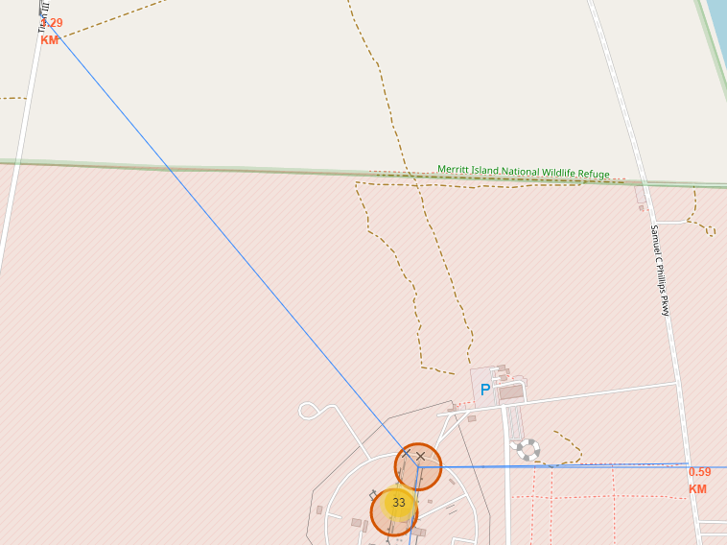
Location Proximities of Launch Sites to Key Locations
Interactive Analysis with FOLIUM
Launch sites in close proximity to railways? YES.
Launch sites in close proximity to highways? YES.
Nearest highway = 0.59km away.
Launch sites in close proximity to railways? YES.
Nearest railway = 1.29 km away.

Slide 36

Launch Success Count for All Sites
Interactive Dashboard with PLOTLY DASH
The launch site KSC LC-39 A had the most successful launches, with 41.7% of the total successful launches.

Slide 37

Highest Launching Success Ratio
Interactive Dashboard with PLOTLY DASH
Launch site KSC LC-39 also has the highest ratio success ratio with a ratio of 76.9%.

Slide 38

Payload Mass vs Success vs Booster version Cateegory
Interactive Dashboard with PLOTLY DASH

Slide 39
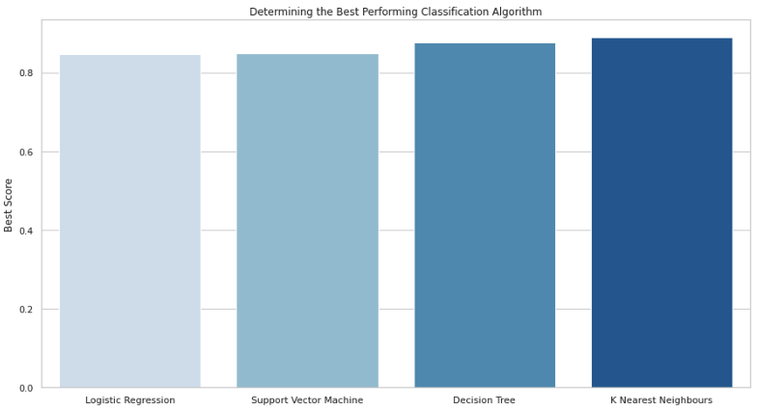
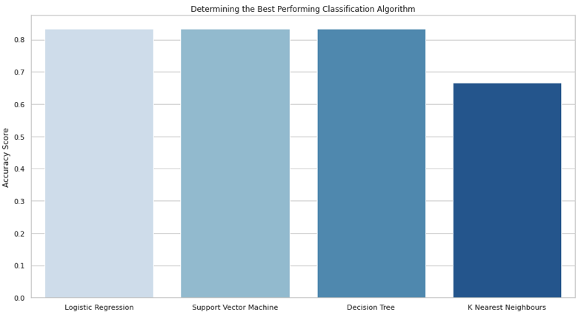
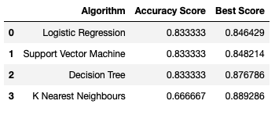
Classification Accuracy
Predictive Analysis - Classification
The Decision Tree model has the highest classification accuracy

Slide 40
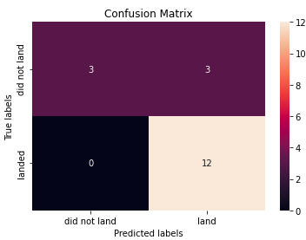
Confusion Matrix
Predictive Analysis - Classification
The models predicted 12 successful landings when the true label was successful landing.
The models predicted 3 unsuccessful landings when the true label was unsuccessful landing.
The models predicted 3 successful landings when the true label was unsuccessful landings (false positives).

Slide 41
Conclusion

Slide 42
Conclusion
As the number of flights increased, the rate of success at a launch site increased.
Most of the early flights were unsuccessful.
Between 2010 and 2013, all landings were unsuccessful
After 2013, the success rate generally increased, despite small dips in 2018 and 2020.
Orbit types ES-L1, GEO, HEO, and SSO, have the highest success rate of 100%.
Launch site KSC LC-39 A had the most successful launches, with 41.7% of the total successful launches, and also the highest rate of successful launches, with a 76.9% success rate.

Slide 43
Appendix
https://github.com/dheyveid/IBM-Data-Science-Capstone-Project

